Slide 1
0 | 0 | 1 | 0
0 | 1 | 0.5 | 0
0 | 0.5 | 1 | 0.5
0.5 | 1 | 0.5 | 1
0
0
0
0.5
0
0
0
0.5
0
1
0.5
1
0
1
0.5
1
1
0.5
1
0.5
1
0.5
1
0.5
0
0
0.5
1
0
0
0.5
1

Slide 2
+
+
+
+
–
+
–
+
+
–
–
–
+
–

Slide 3
–
+
+
+
–
–
–
–
–
–
+
+
–
–
–
+
–
+
–
–
+
+
–
+
+
–
+
–
+
–
+
+
–
–
+
+
+
–
+
–
–
–
+
+
+
–
–
–
+
+
+
+
+
+
–
–
+
+
+
+
–
+
+
–
+
–
–
–
–
+
–
+
–
–
–
–
+
–
–
–
+
+
–
–
–
–
–
–
–
+
+
–
–
–
–
–
–
+
+
–
–

Slide 4
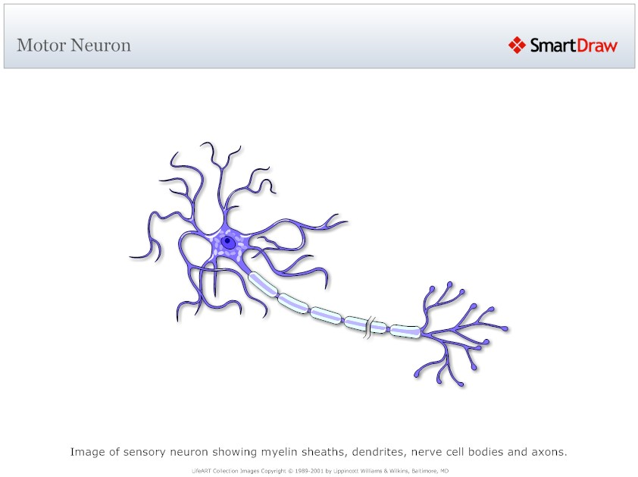
Inputs
Strengths
dendrites
Sum
Transform
Output

Slide 5
synaptic terminal
dendrites
cell body
axon
Inputs
Strengths
Sum
Transform
Output

Slide 6
0 | 0 | 1 | 0
0 | 1 | 0.5 | 0
0 | 0.5 | 1 | 0.5
0.5 | 1 | 0.5 | 1

Slide 8
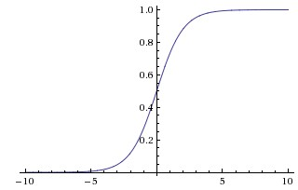

Slide 9
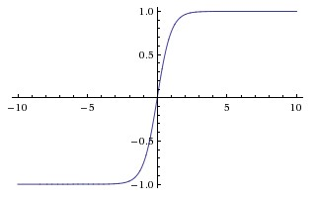

Slide 10
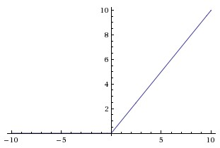

Slide 14
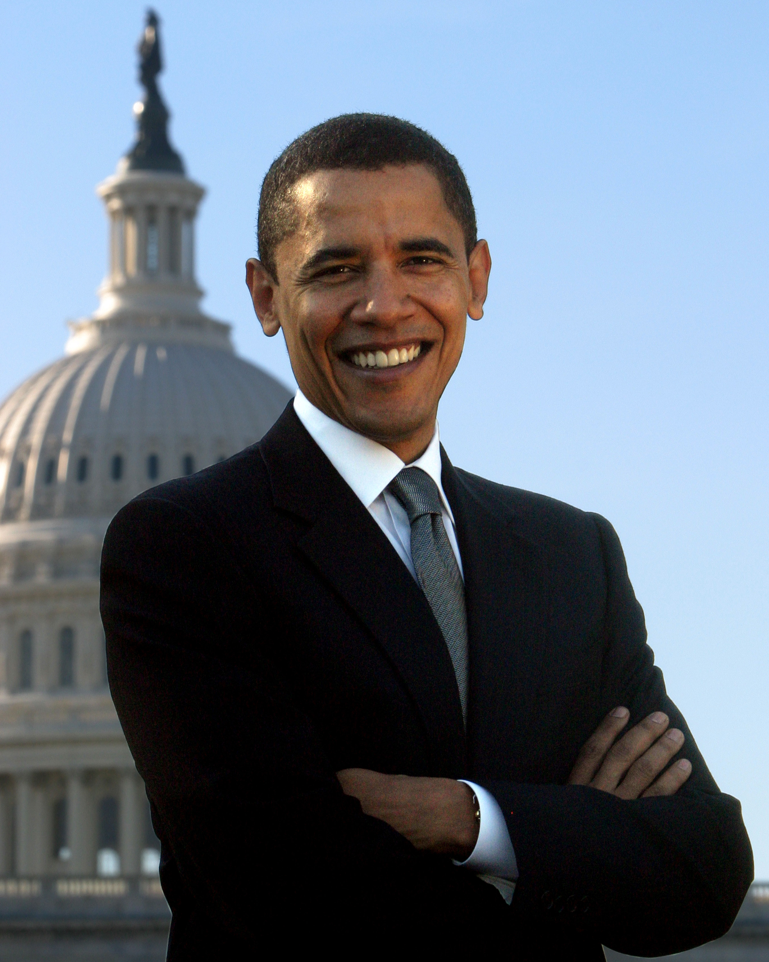

Slide 15
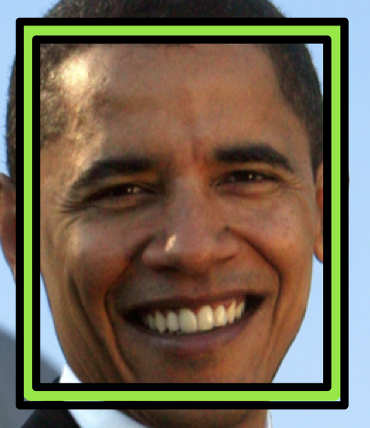

Slide 17
d
w
h

Slide 18
?

Slide 20
Feature Map
Filter

Slide 21
Filter
1
-1
2
8
7
-7
-2
5
8
-7
5
1
5
3
-4
2
2
-1
1
5
3
-4
2
2
-1
S = 1
S = 2

Slide 22
0 | 0 | 0 | 0 | 0 | 0 | 0
0 | -1 | 1 | 1 | 1 | -1 | 0
0 | 1 | -1 | 1 | 1 | -1 | 0
0 | 0 | -1 | 1 | 1 | 0 | 0
0 | -1 | 1 | 1 | 1 | 0 | 0
0 | 1 | 1 | -1 | 1 | -1 | 0
0 | 0 | 0 | 0 | 0 | 0 | 0
0 | 0 | 0
0 | -1 | 1
0 | 1 | -1
1 | 0 | 0
0 | 1 | 1
1 | -1 | -1
0 | 0 | 0 | 0 | 0 | 0 | 0
0 | 1 | -1 | -1 | 1 | -1 | 0
0 | 1 | -1 | 0 | 1 | -1 | 0
0 | 1 | 0 | 0 | -1 | 0 | 0
0 | -1 | 1 | 1 | 1 | 1 | 0
0 | -1 | 1 | 0 | -1 | -1 | 0
0 | 0 | 0 | 0 | 0 | 0 | 0
7 | -3 | -2
-3 | 1 | 3
-2 | 4 | 2
1 | 0 | 0
0 | 0 | -1
0 | 1 | 1
1 | 1 | 0
1 | 1 | -1
1 | -1 | -1
3 | -6 | 3
1 | -1 | 2
-1 | 5 | 0
0 | 0 | 0 | 0 | 0 | 0 | 0
0 | 1 | -1 | -1 | 0 | -1 | 0
0 | 1 | -1 | 0 | 1 | 0 | 0
0 | 1 | 0 | 0 | -1 | 0 | 0
0 | 0 | 1 | 0 | 0 | 1 | 0
0 | -1 | -1 | 1 | -1 | 0 | 0
0 | 0 | 0 | 0 | 0 | 0 | 0
1 | 1 | 1
1 | 1 | 1
0 | 1 | -1
0 | 0 | 0
0 | 0 | 0
0 | 1 | 0

Slide 23
0 | 0 | 0 | 0 | 0 | 0 | 0
0 | -1 | 1 | 1 | 1 | -1 | 0
0 | 1 | -1 | 1 | 1 | -1 | 0
0 | 0 | -1 | 1 | 1 | 0 | 0
0 | -1 | 1 | 1 | 1 | 0 | 0
0 | 1 | 1 | -1 | 1 | -1 | 0
0 | 0 | 0 | 0 | 0 | 0 | 0
0 | 0 | 0
0 | -1 | 1
0 | 1 | -1
1 | 0 | 0
0 | 1 | 1
1 | -1 | -1
0 | 0 | 0 | 0 | 0 | 0 | 0
0 | 1 | -1 | -1 | 1 | -1 | 0
0 | 1 | -1 | 0 | 1 | -1 | 0
0 | 1 | 0 | 0 | -1 | 0 | 0
0 | -1 | 1 | 1 | 1 | 1 | 0
0 | -1 | 1 | 0 | -1 | -1 | 0
0 | 0 | 0 | 0 | 0 | 0 | 0
7 | -3 | -2
-3 | 1 | 3
-2 | 4 | 2
1 | 0 | 0
0 | 0 | -1
0 | 1 | 1
1 | 1 | 0
1 | 1 | -1
1 | -1 | -1
3 | -6 | 3
1 | -1 | 2
-1 | 5 | 0
0 | 0 | 0 | 0 | 0 | 0 | 0
0 | 1 | -1 | -1 | 0 | -1 | 0
0 | 1 | -1 | 0 | 1 | 0 | 0
0 | 1 | 0 | 0 | -1 | 0 | 0
0 | 0 | 1 | 0 | 0 | 1 | 0
0 | -1 | -1 | 1 | -1 | 0 | 0
0 | 0 | 0 | 0 | 0 | 0 | 0
1 | 1 | 1
1 | 1 | 1
0 | 1 | -1
0 | 0 | 0
0 | 0 | 0
0 | 1 | 0

Slide 24
0 | 0 | 0 | 0 | 0 | 0 | 0
0 | -1 | 1 | 1 | 1 | -1 | 0
0 | 1 | -1 | 1 | 1 | -1 | 0
0 | 0 | -1 | 1 | 1 | 0 | 0
0 | -1 | 1 | 1 | 1 | 0 | 0
0 | 1 | 1 | -1 | 1 | -1 | 0
0 | 0 | 0 | 0 | 0 | 0 | 0
0 | 0 | 0
0 | -1 | 1
0 | 1 | -1
1 | 0 | 0
0 | 1 | 1
1 | -1 | -1
0 | 0 | 0 | 0 | 0 | 0 | 0
0 | 1 | -1 | -1 | 1 | -1 | 0
0 | 1 | -1 | 0 | 1 | -1 | 0
0 | 1 | 0 | 0 | -1 | 0 | 0
0 | -1 | 1 | 1 | 1 | 1 | 0
0 | -1 | 1 | 0 | -1 | -1 | 0
0 | 0 | 0 | 0 | 0 | 0 | 0
7 | -3 | -2
-3 | 1 | 3
-2 | 4 | 2
1 | 0 | 0
0 | 0 | -1
0 | 1 | 1
1 | 1 | 0
1 | 1 | -1
1 | -1 | -1
3 | -6 | 3
1 | -1 | 2
-1 | 5 | 0
0 | 0 | 0 | 0 | 0 | 0 | 0
0 | 1 | -1 | -1 | 0 | -1 | 0
0 | 1 | -1 | 0 | 1 | 0 | 0
0 | 1 | 0 | 0 | -1 | 0 | 0
0 | 0 | 1 | 0 | 0 | 1 | 0
0 | -1 | -1 | 1 | -1 | 0 | 0
0 | 0 | 0 | 0 | 0 | 0 | 0
1 | 1 | 1
1 | 1 | 1
0 | 1 | -1
0 | 0 | 0
0 | 0 | 0
0 | 1 | 0

Slide 25
0 | 0 | 0 | 0 | 0 | 0 | 0
0 | -1 | 1 | 1 | 1 | -1 | 0
0 | 1 | -1 | 1 | 1 | -1 | 0
0 | 0 | -1 | 1 | 1 | 0 | 0
0 | -1 | 1 | 1 | 1 | 0 | 0
0 | 1 | 1 | -1 | 1 | -1 | 0
0 | 0 | 0 | 0 | 0 | 0 | 0
0 | 0 | 0
0 | -1 | 1
0 | 1 | -1
1 | 0 | 0
0 | 1 | 1
1 | -1 | -1
0 | 0 | 0 | 0 | 0 | 0 | 0
0 | 1 | -1 | -1 | 1 | -1 | 0
0 | 1 | -1 | 0 | 1 | -1 | 0
0 | 1 | 0 | 0 | -1 | 0 | 0
0 | -1 | 1 | 1 | 1 | 1 | 0
0 | -1 | 1 | 0 | -1 | -1 | 0
0 | 0 | 0 | 0 | 0 | 0 | 0
7 | -3 | -2
-3 | 1 | 3
-2 | 4 | 2
1 | 0 | 0
0 | 0 | -1
0 | 1 | 1
1 | 1 | 0
1 | 1 | -1
1 | -1 | -1
3 | -6 | 3
1 | -1 | 2
-1 | 5 | 0
0 | 0 | 0 | 0 | 0 | 0 | 0
0 | 1 | -1 | -1 | 0 | -1 | 0
0 | 1 | -1 | 0 | 1 | 0 | 0
0 | 1 | 0 | 0 | -1 | 0 | 0
0 | 0 | 1 | 0 | 0 | 1 | 0
0 | -1 | -1 | 1 | -1 | 0 | 0
0 | 0 | 0 | 0 | 0 | 0 | 0
1 | 1 | 1
1 | 1 | 1
0 | 1 | -1
0 | 0 | 0
0 | 0 | 0
0 | 1 | 0

Slide 26
0 | 0 | 0 | 0 | 0 | 0 | 0
0 | -1 | 1 | 1 | 1 | -1 | 0
0 | 1 | -1 | 1 | 1 | -1 | 0
0 | 0 | -1 | 1 | 1 | 0 | 0
0 | -1 | 1 | 1 | 1 | 0 | 0
0 | 1 | 1 | -1 | 1 | -1 | 0
0 | 0 | 0 | 0 | 0 | 0 | 0
0 | 0 | 0
0 | -1 | 1
0 | 1 | -1
1 | 0 | 0
0 | 1 | 1
1 | -1 | -1
0 | 0 | 0 | 0 | 0 | 0 | 0
0 | 1 | -1 | -1 | 1 | -1 | 0
0 | 1 | -1 | 0 | 1 | -1 | 0
0 | 1 | 0 | 0 | -1 | 0 | 0
0 | -1 | 1 | 1 | 1 | 1 | 0
0 | -1 | 1 | 0 | -1 | -1 | 0
0 | 0 | 0 | 0 | 0 | 0 | 0
7 | -3 | -2
-3 | 1 | 3
-2 | 4 | 2
1 | 0 | 0
0 | 0 | -1
0 | 1 | 1
1 | 1 | 0
1 | 1 | -1
1 | -1 | -1
3 | -6 | 3
1 | -1 | 2
-1 | 5 | 0
0 | 0 | 0 | 0 | 0 | 0 | 0
0 | 1 | -1 | -1 | 0 | -1 | 0
0 | 1 | -1 | 0 | 1 | 0 | 0
0 | 1 | 0 | 0 | -1 | 0 | 0
0 | 0 | 1 | 0 | 0 | 1 | 0
0 | -1 | -1 | 1 | -1 | 0 | 0
0 | 0 | 0 | 0 | 0 | 0 | 0
1 | 1 | 1
1 | 1 | 1
0 | 1 | -1
0 | 0 | 0
0 | 0 | 0
0 | 1 | 0

Slide 27
0 | 0 | 0 | 0 | 0 | 0 | 0
0 | -1 | 1 | 1 | 1 | -1 | 0
0 | 1 | -1 | 1 | 1 | -1 | 0
0 | 0 | -1 | 1 | 1 | 0 | 0
0 | -1 | 1 | 1 | 1 | 0 | 0
0 | 1 | 1 | -1 | 1 | -1 | 0
0 | 0 | 0 | 0 | 0 | 0 | 0
0 | 0 | 0
0 | -1 | 1
0 | 1 | -1
1 | 0 | 0
0 | 1 | 1
1 | -1 | -1
0 | 0 | 0 | 0 | 0 | 0 | 0
0 | 1 | -1 | -1 | 1 | -1 | 0
0 | 1 | -1 | 0 | 1 | -1 | 0
0 | 1 | 0 | 0 | -1 | 0 | 0
0 | -1 | 1 | 1 | 1 | 1 | 0
0 | -1 | 1 | 0 | -1 | -1 | 0
0 | 0 | 0 | 0 | 0 | 0 | 0
7 | -3 | -2
-3 | 1 | 3
-2 | 4 | 2
1 | 0 | 0
0 | 0 | -1
0 | 1 | 1
1 | 1 | 0
1 | 1 | -1
1 | -1 | -1
3 | -6 | 3
1 | -1 | 2
-1 | 5 | 0
0 | 0 | 0 | 0 | 0 | 0 | 0
0 | 1 | -1 | -1 | 0 | -1 | 0
0 | 1 | -1 | 0 | 1 | 0 | 0
0 | 1 | 0 | 0 | -1 | 0 | 0
0 | 0 | 1 | 0 | 0 | 1 | 0
0 | -1 | -1 | 1 | -1 | 0 | 0
0 | 0 | 0 | 0 | 0 | 0 | 0
1 | 1 | 1
1 | 1 | 1
0 | 1 | -1
0 | 0 | 0
0 | 0 | 0
0 | 1 | 0

Slide 28
0 | 0 | 0 | 0 | 0 | 0 | 0
0 | -1 | 1 | 1 | 1 | -1 | 0
0 | 1 | -1 | 1 | 1 | -1 | 0
0 | 0 | -1 | 1 | 1 | 0 | 0
0 | -1 | 1 | 1 | 1 | 0 | 0
0 | 1 | 1 | -1 | 1 | -1 | 0
0 | 0 | 0 | 0 | 0 | 0 | 0
0 | 0 | 0
0 | -1 | 1
0 | 1 | -1
1 | 0 | 0
0 | 1 | 1
1 | -1 | -1
0 | 0 | 0 | 0 | 0 | 0 | 0
0 | 1 | -1 | -1 | 1 | -1 | 0
0 | 1 | -1 | 0 | 1 | -1 | 0
0 | 1 | 0 | 0 | -1 | 0 | 0
0 | -1 | 1 | 1 | 1 | 1 | 0
0 | -1 | 1 | 0 | -1 | -1 | 0
0 | 0 | 0 | 0 | 0 | 0 | 0
7 | -3 | -2
-3 | 1 | 3
-2 | 4 | 2
1 | 0 | 0
0 | 0 | -1
0 | 1 | 1
1 | 1 | 0
1 | 1 | -1
1 | -1 | -1
3 | -6 | 3
1 | -1 | 2
-1 | 5 | 0
0 | 0 | 0 | 0 | 0 | 0 | 0
0 | 1 | -1 | -1 | 0 | -1 | 0
0 | 1 | -1 | 0 | 1 | 0 | 0
0 | 1 | 0 | 0 | -1 | 0 | 0
0 | 0 | 1 | 0 | 0 | 1 | 0
0 | -1 | -1 | 1 | -1 | 0 | 0
0 | 0 | 0 | 0 | 0 | 0 | 0
1 | 1 | 1
1 | 1 | 1
0 | 1 | -1
0 | 0 | 0
0 | 0 | 0
0 | 1 | 0

Slide 29
0 | 0 | 0 | 0 | 0 | 0 | 0
0 | -1 | 1 | 1 | 1 | -1 | 0
0 | 1 | -1 | 1 | 1 | -1 | 0
0 | 0 | -1 | 1 | 1 | 0 | 0
0 | -1 | 1 | 1 | 1 | 0 | 0
0 | 1 | 1 | -1 | 1 | -1 | 0
0 | 0 | 0 | 0 | 0 | 0 | 0
0 | 0 | 0
0 | -1 | 1
0 | 1 | -1
1 | 0 | 0
0 | 1 | 1
1 | -1 | -1
0 | 0 | 0 | 0 | 0 | 0 | 0
0 | 1 | -1 | -1 | 1 | -1 | 0
0 | 1 | -1 | 0 | 1 | -1 | 0
0 | 1 | 0 | 0 | -1 | 0 | 0
0 | -1 | 1 | 1 | 1 | 1 | 0
0 | -1 | 1 | 0 | -1 | -1 | 0
0 | 0 | 0 | 0 | 0 | 0 | 0
7 | -3 | -2
-3 | 1 | 3
-2 | 4 | 2
1 | 0 | 0
0 | 0 | -1
0 | 1 | 1
1 | 1 | 0
1 | 1 | -1
1 | -1 | -1
3 | -6 | 3
1 | -1 | 2
-1 | 5 | 0
0 | 0 | 0 | 0 | 0 | 0 | 0
0 | 1 | -1 | -1 | 0 | -1 | 0
0 | 1 | -1 | 0 | 1 | 0 | 0
0 | 1 | 0 | 0 | -1 | 0 | 0
0 | 0 | 1 | 0 | 0 | 1 | 0
0 | -1 | -1 | 1 | -1 | 0 | 0
0 | 0 | 0 | 0 | 0 | 0 | 0
1 | 1 | 1
1 | 1 | 1
0 | 1 | -1
0 | 0 | 0
0 | 0 | 0
0 | 1 | 0

Slide 31

?

Slide 32
tf.random_normal
tf.assign
weights

Slide 33
output
tf.add
biases
tf.matmul
W
x

Slide 34
/cpu:0
tf.add_n
/gpu:0
/gpu:1
tf.matmul
tf.matmul
a
b
a
b

Slide 35
tf..nn.relu
tf.add
output/biases
tf.matmul
output/W
tf..nn.relu
tf.add
hidden_2/biases
tf.matmul
hidden_2/W
tf..nn.relu
tf.add
hidden_1/biases
tf.matmul
hidden_1/W
x

Slide 36
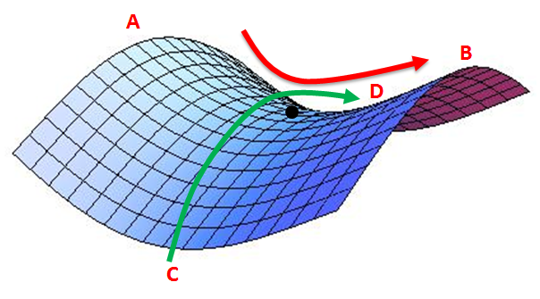
A
B
D
C

Slide 39
softmax
fc
fc
pool
conv
softmax
conv
fc
conv
softmax
fc
(repeated 3 times)
fc
pool
pool
softmax
pool
conv
conv
fc
conv
conv
conv
conv
(repeated 1-2 times)
(repeated 3-4 times)
(repeated 2 times)
input
input
input
input

Slide 40
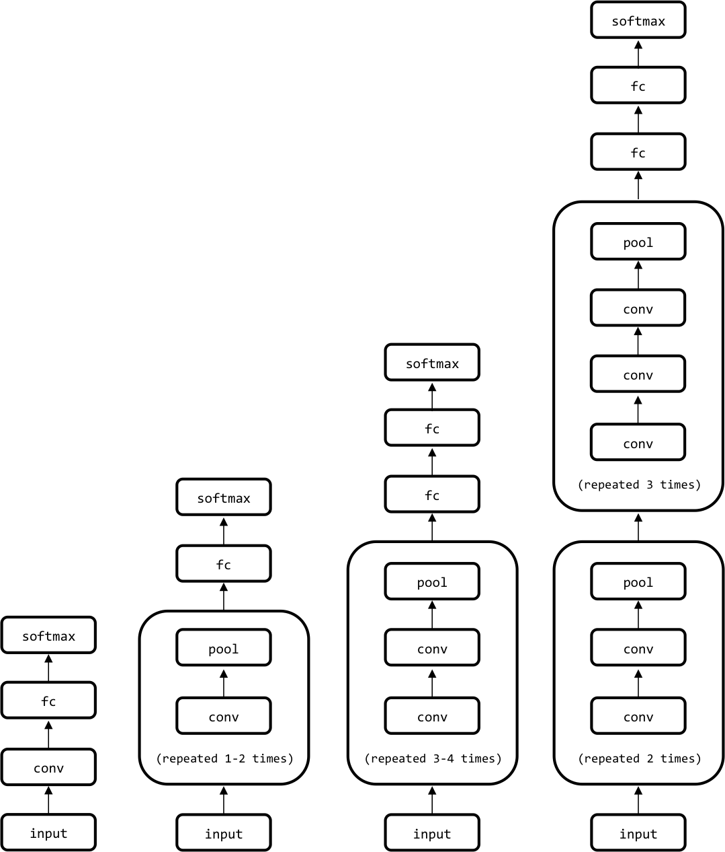

Slide 42
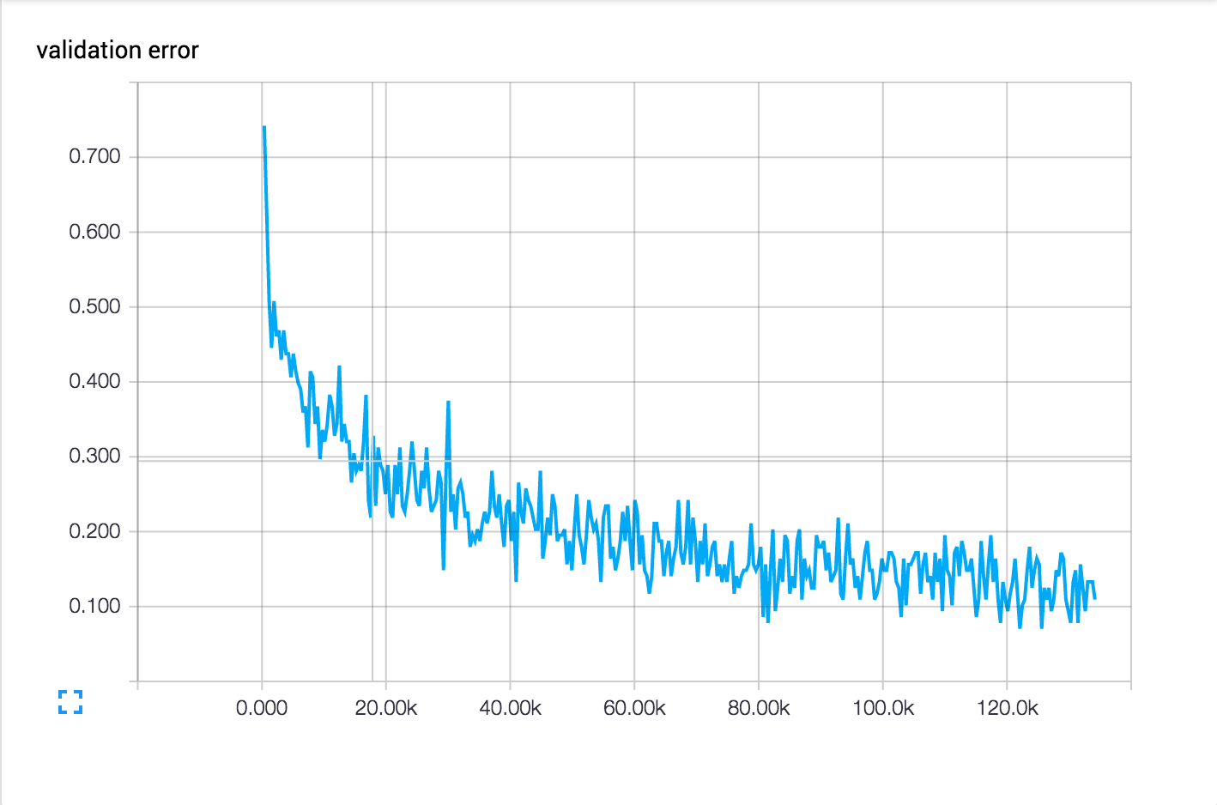
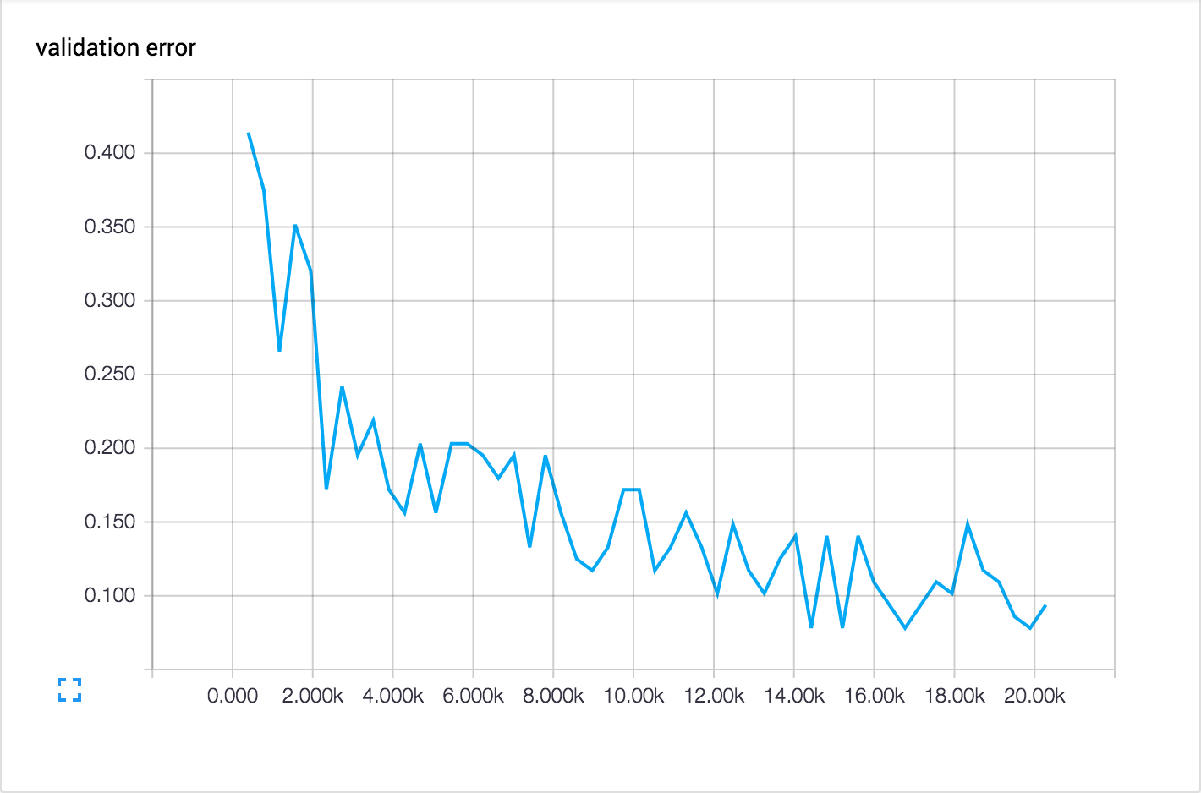

Slide 44
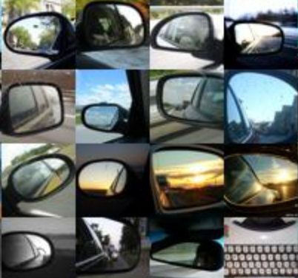
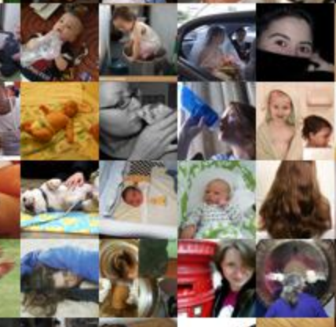
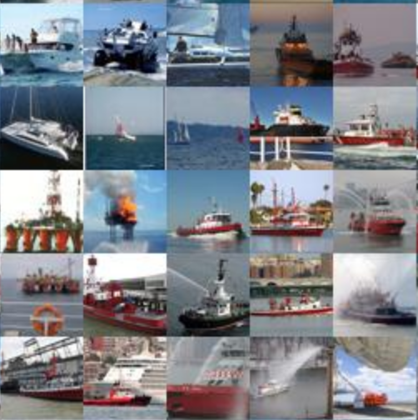
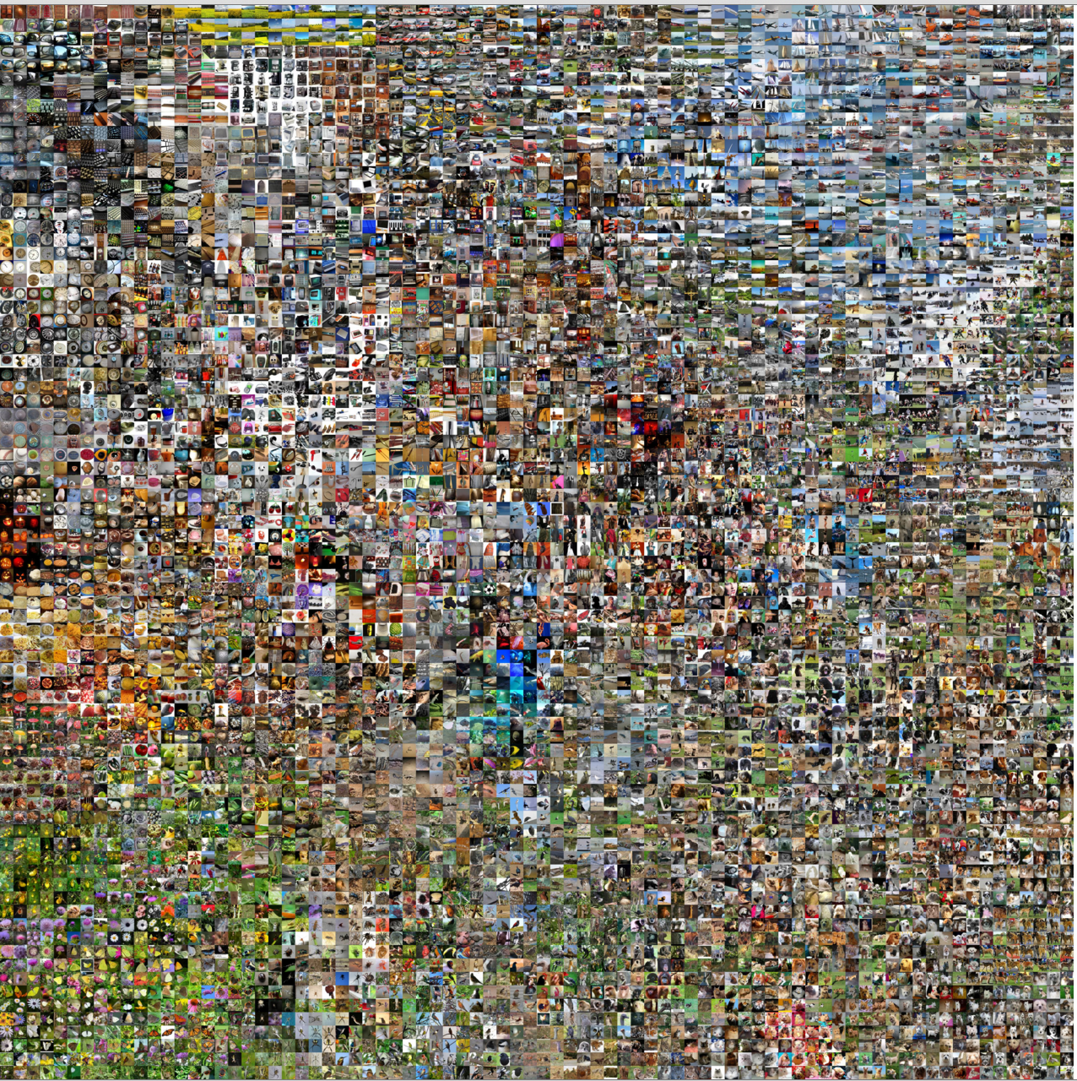
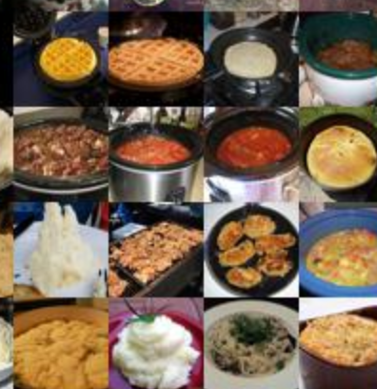
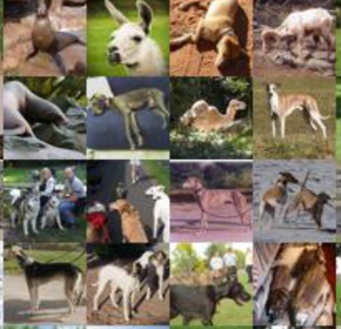
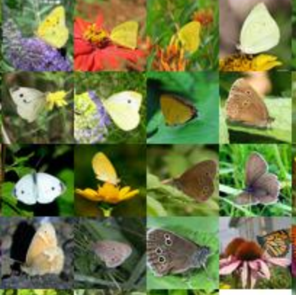
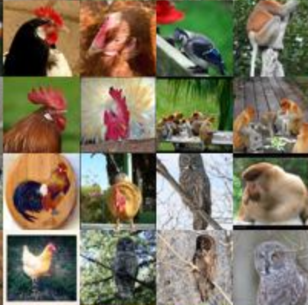
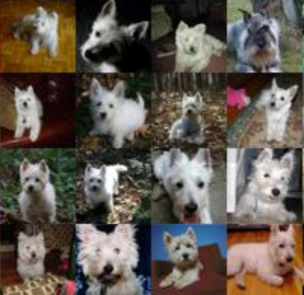

Slide 46

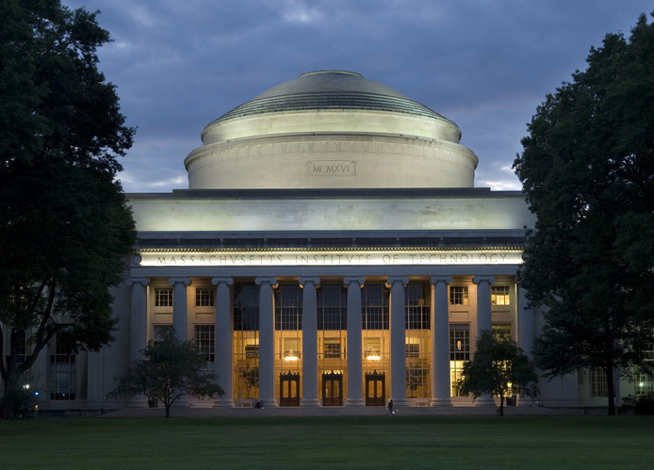
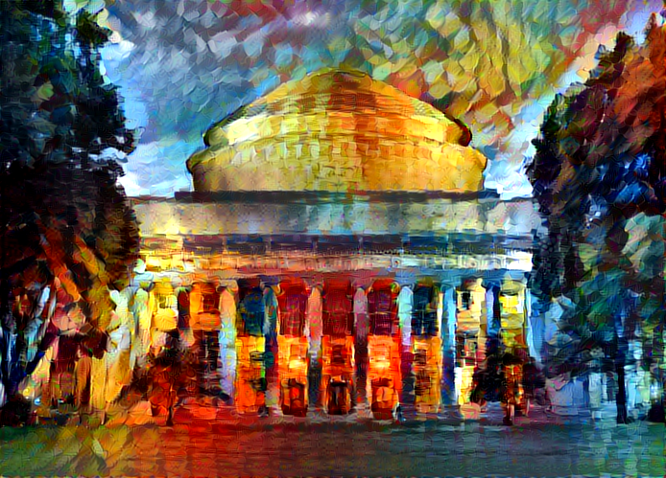

Slide 47
embedding algorithm
(unsupervised with lots of data)
input
embedding
predictive algorithm
(supervised with less data)
embedding
output

Slide 49
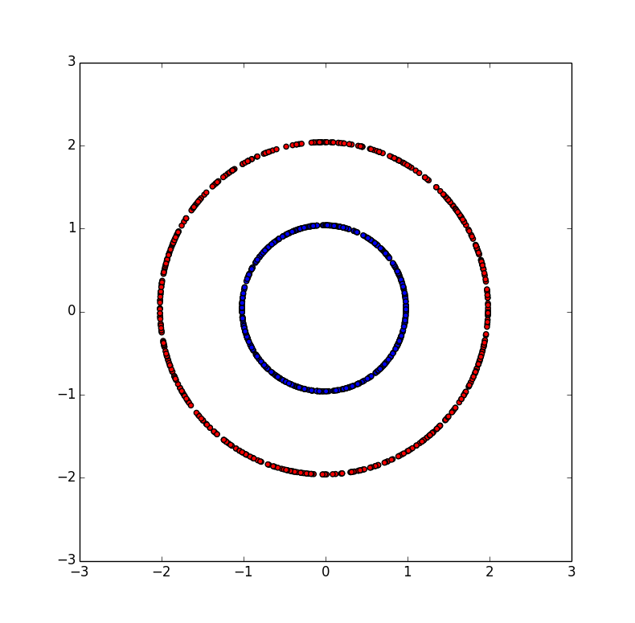
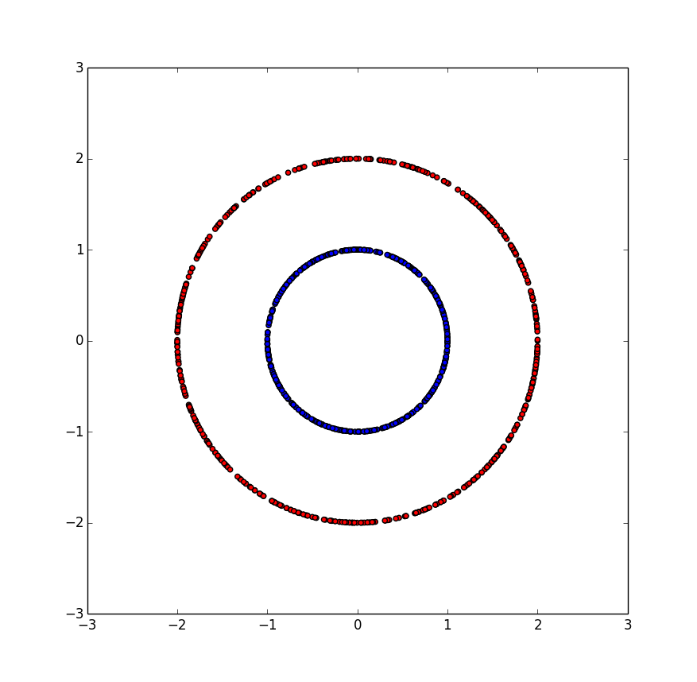
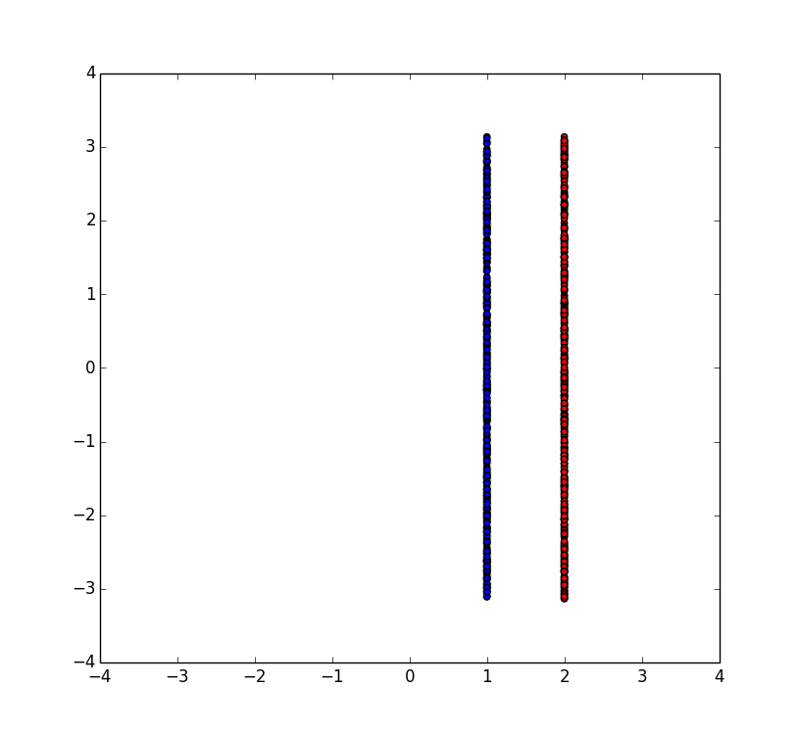
PCA
Polar Transform

Slide 50
encoder
decoder
input
embedding
Reconstructed input

Slide 51
784
1000
500
250
2
250
500
1000
784

Slide 52
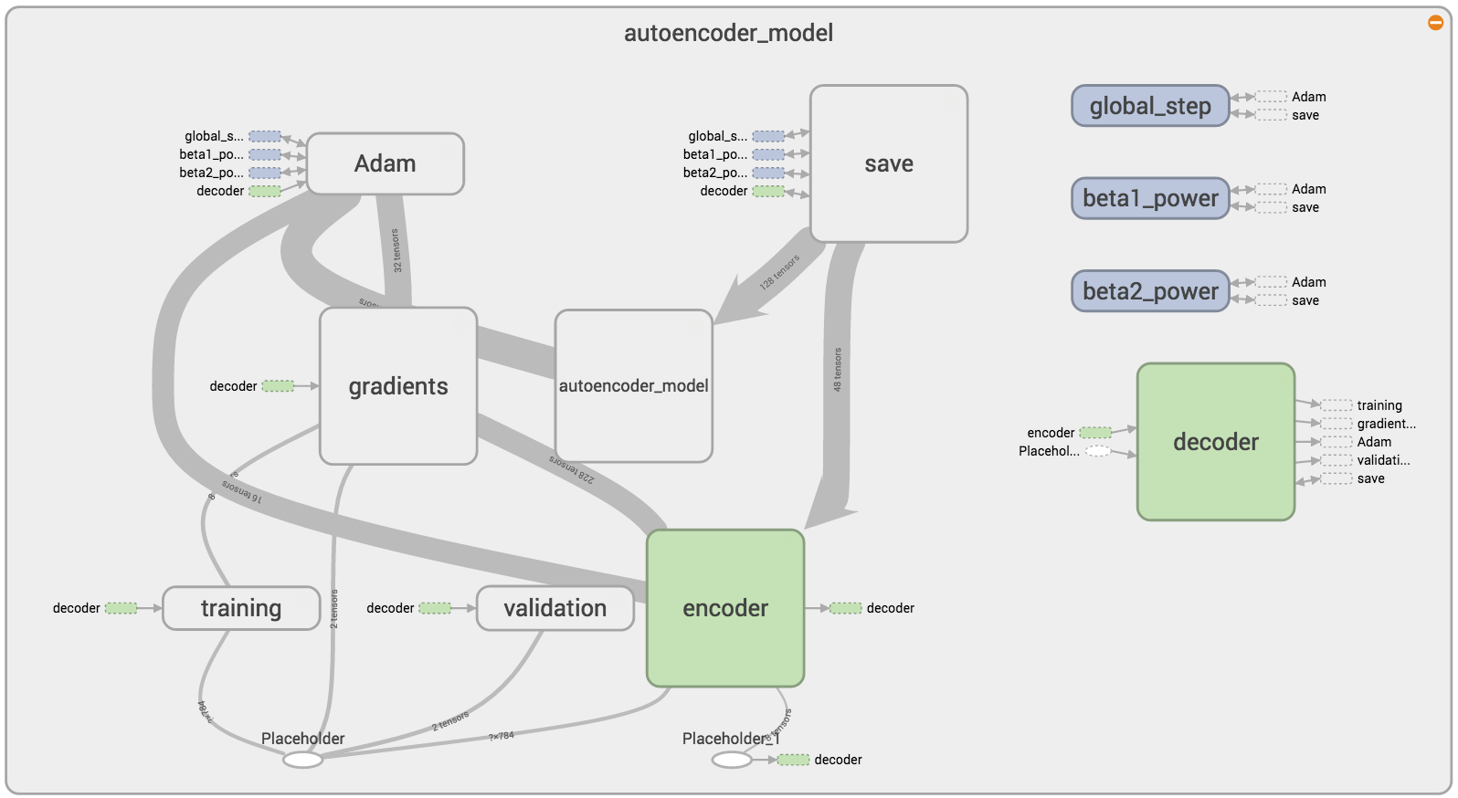
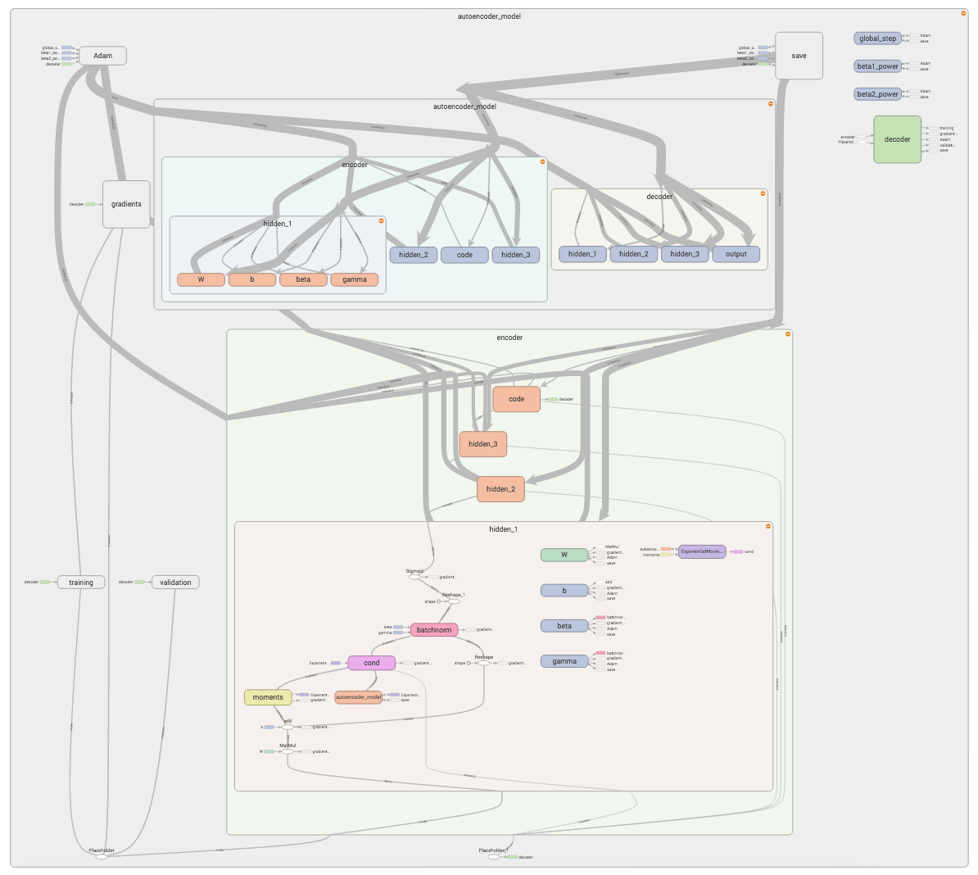

Slide 53
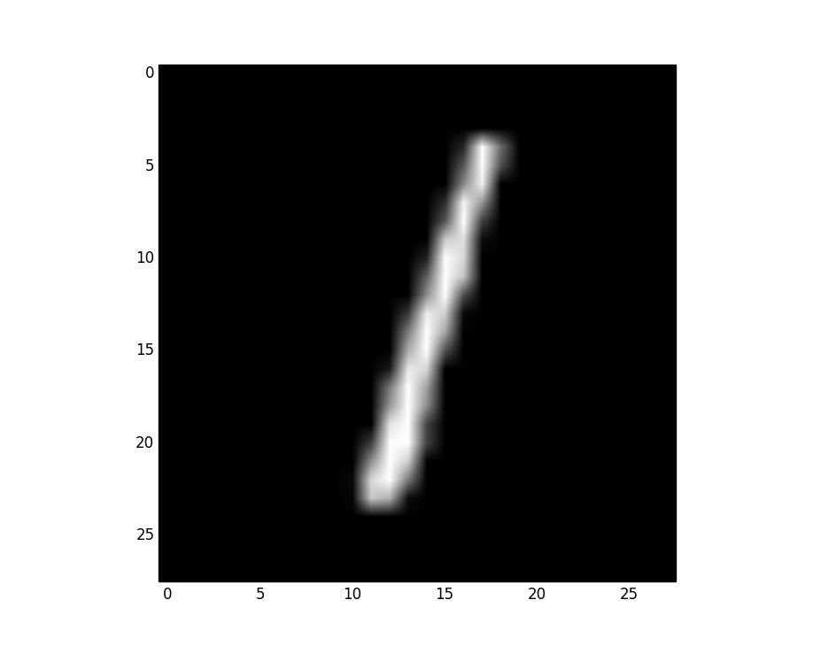
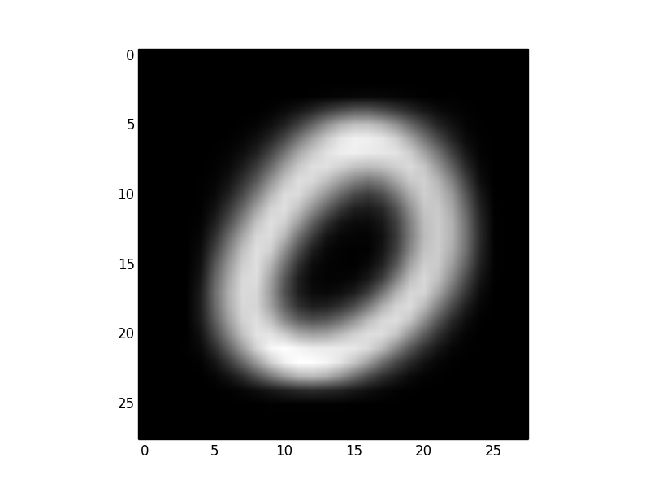
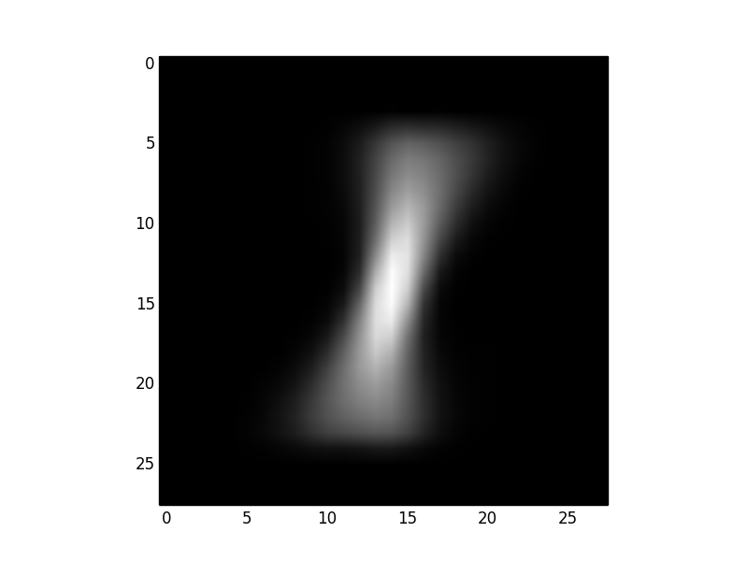
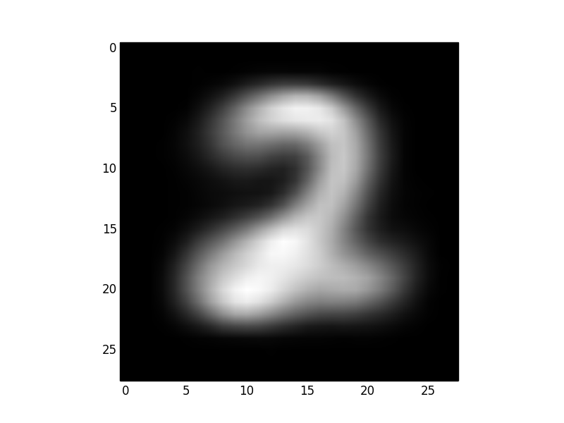
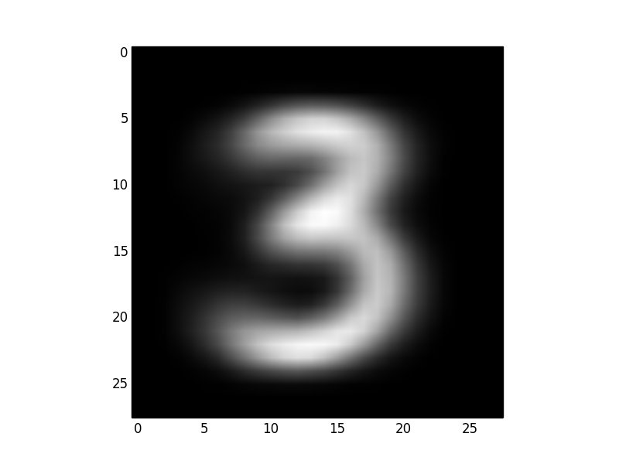
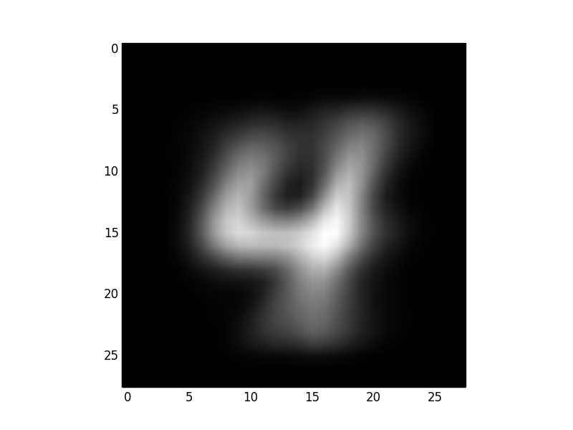
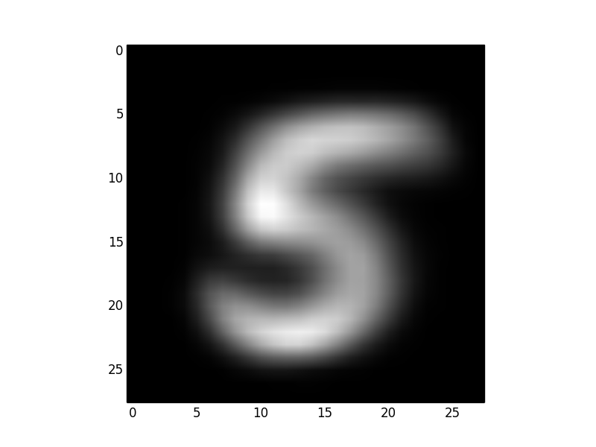
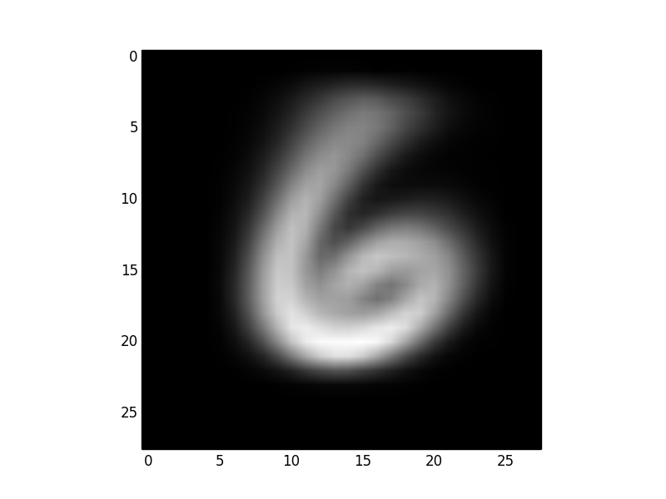
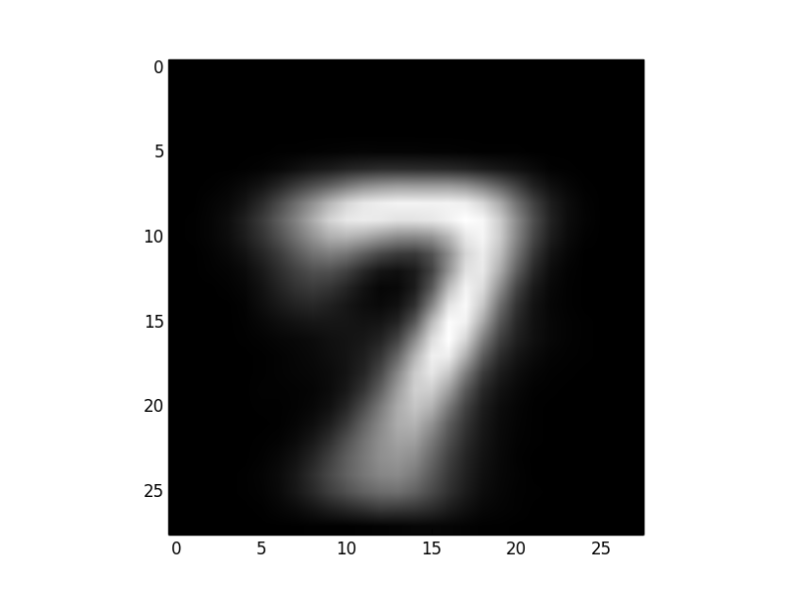
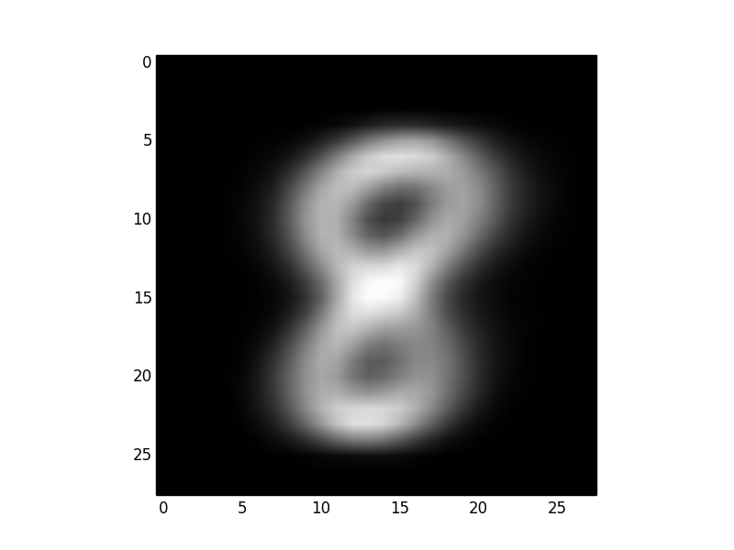
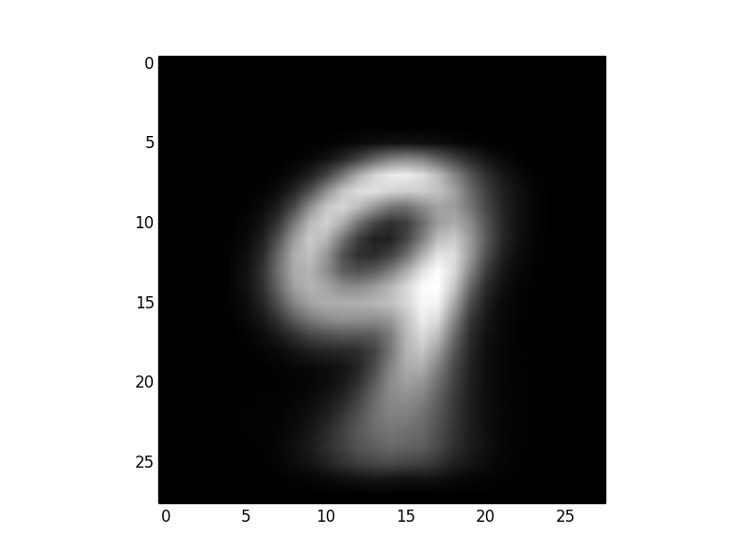
avg(L2)=11.05
avg(L2)=5.75
avg(L2)=9.61
avg(L2)=9.46
avg(L2)=9.35
avg(L2)=9.41
avg(L2)=9.80
avg(L2)=8.94
avg(L2)=9.57
avg(L2)=9.28

Slide 54
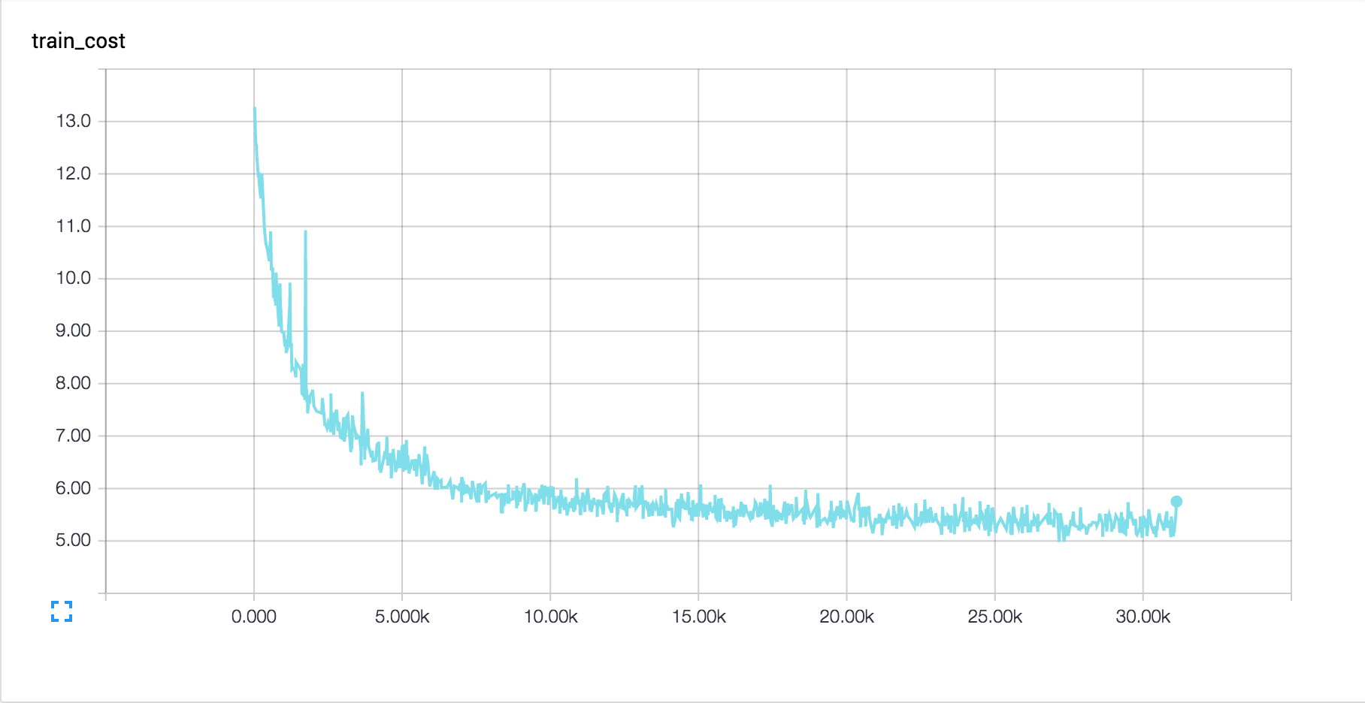
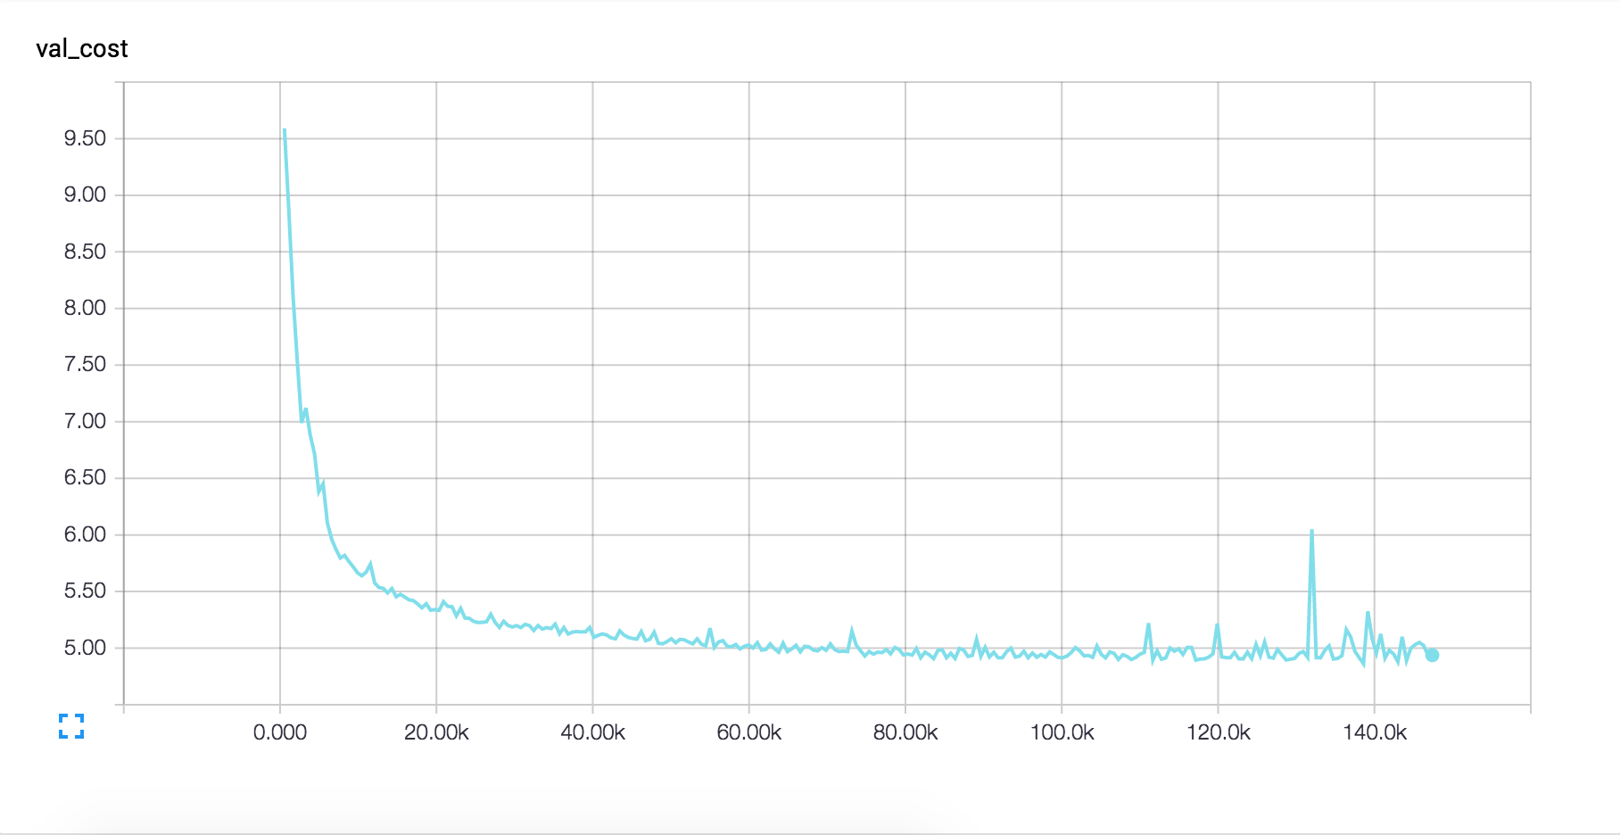

Slide 55
Original inputs
Reconstructions
5 Epochs
Reconstructions
100 Epochs
Reconstructions
200 Epochs

Slide 56
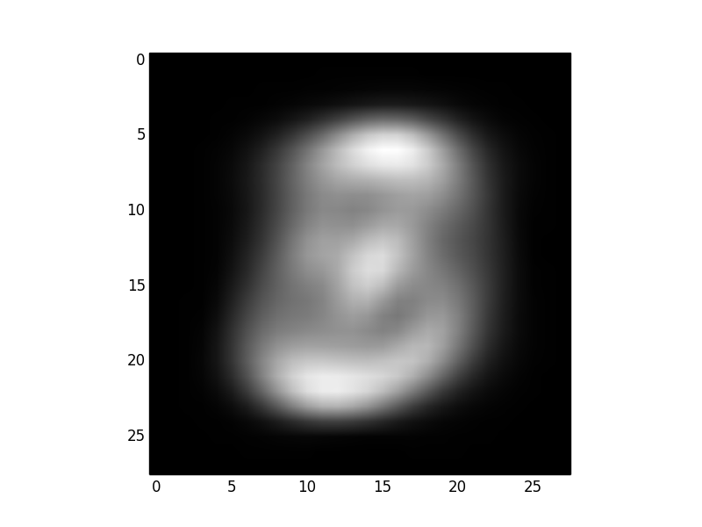
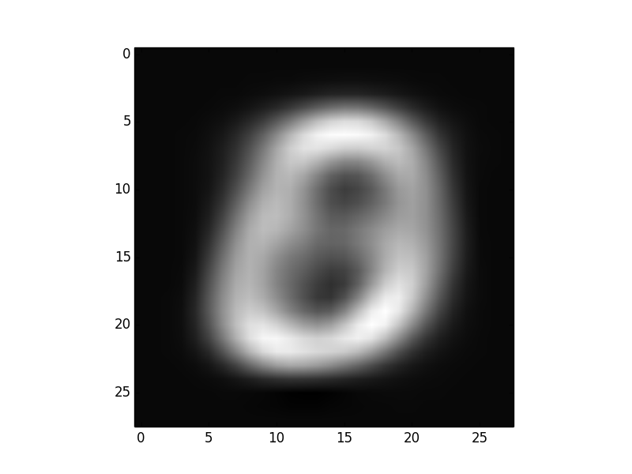
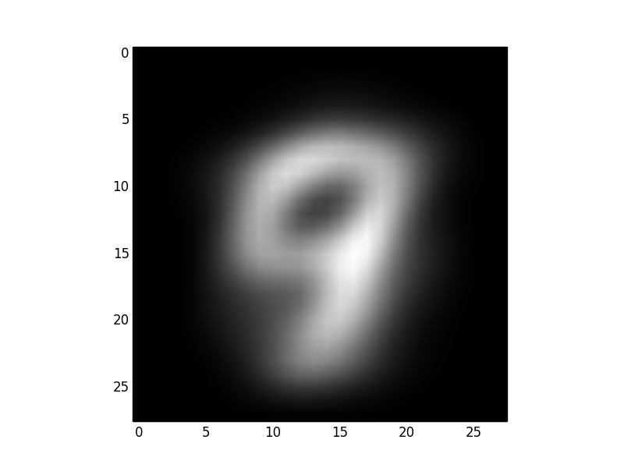
Original inputs
Reconstructions
2 dim, PCA
Reconstructions
200 Epochs, 2 dim, AE

Slide 57
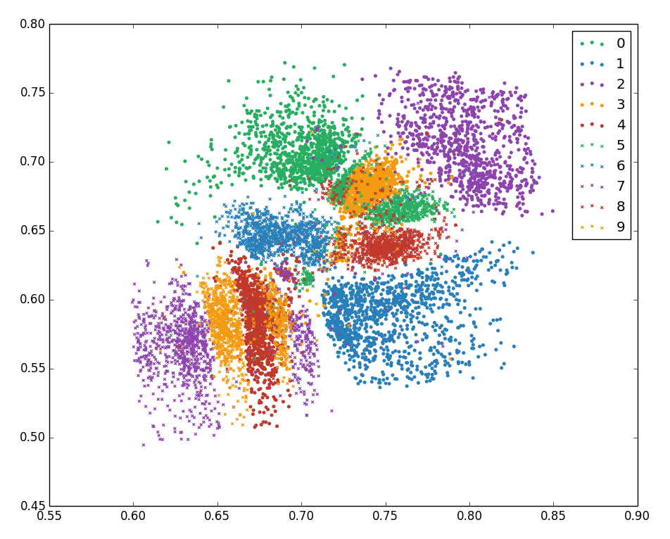
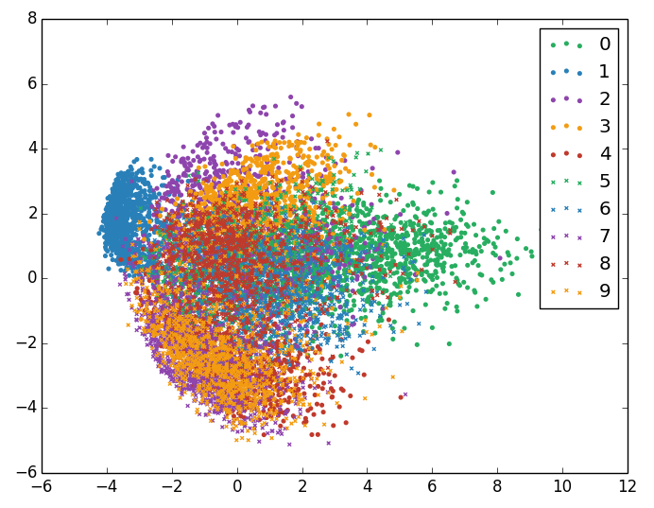

Slide 58
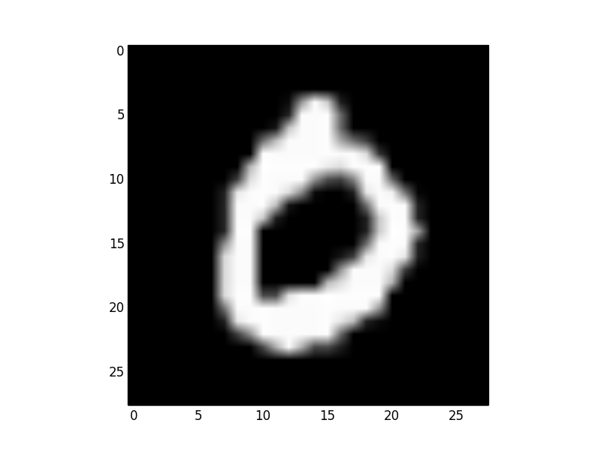
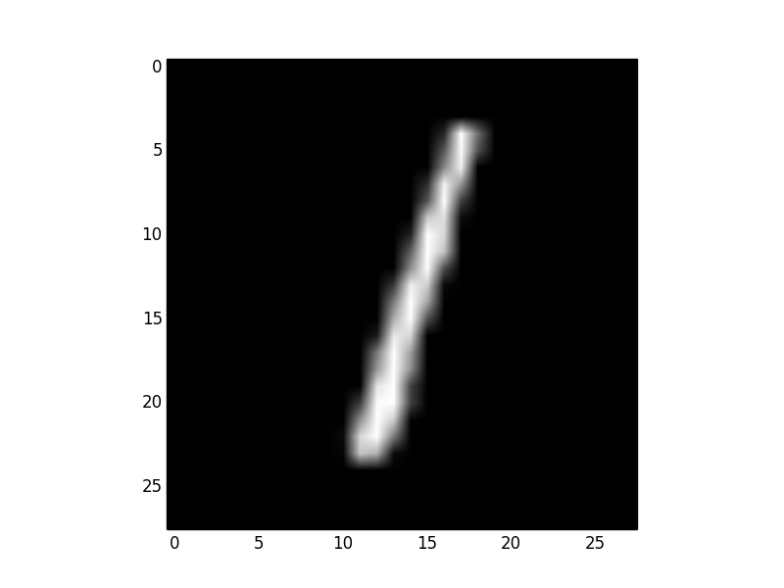
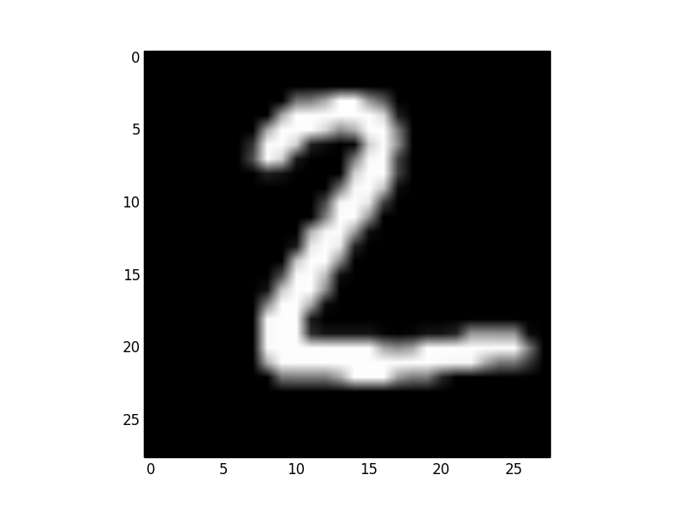
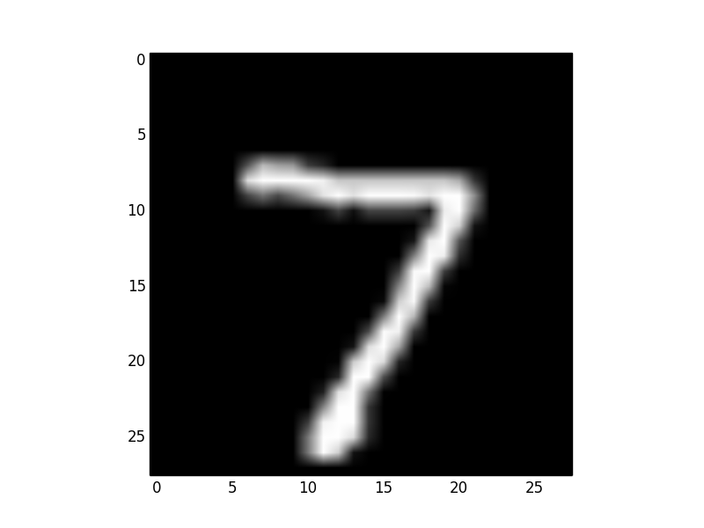
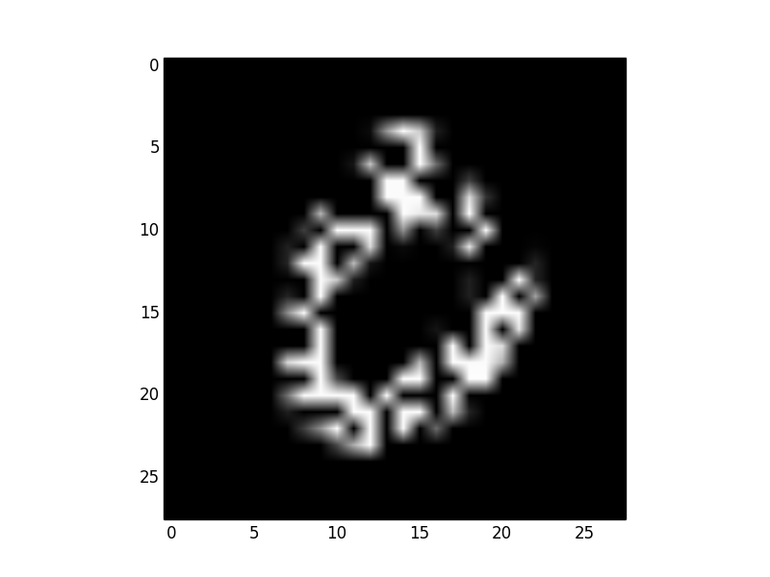
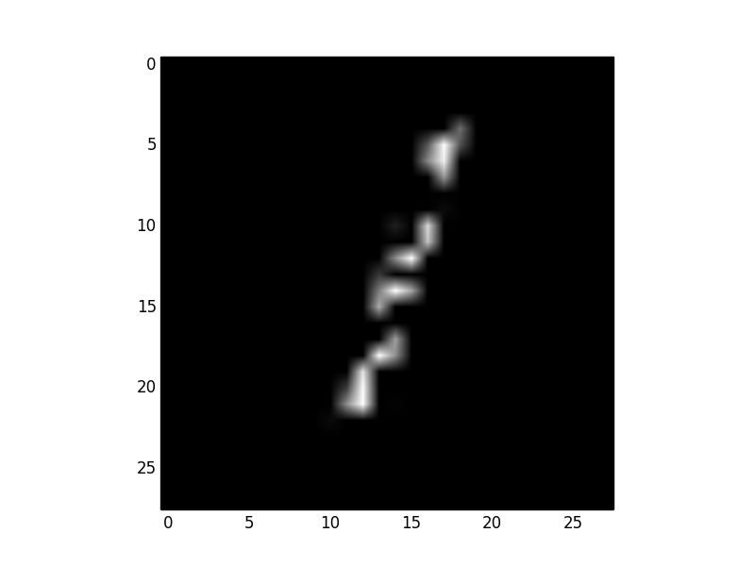



Slide 59
A
B
C

Slide 60
Original images
Corrupted images
Reconstructed images

Slide 62
A
B

Slide 63
the quick brown fox jumps over the lazy dog
1
0
0
0
0
0
0
0
0
1
0
0
0
0
0
0
0
0
1
0
0
0
0
0
0
0
0
1
0
0
0
0
0
0
0
0
1
0
0
0
0
0
0
0
0
1
0
0
1
0
0
0
0
0
0
0
0
0
0
0
0
0
1
0
0
0
0
0
0
0
0
1

Slide 64
A
encoder
decoder
word
embedding
context
B
encoder
decoder
context
embedding
word

Slide 65
Brown fox jumps over the dog
Brown fox leaps over the dog
The boy jumps over the fence
The boy leaps over the fence
The man jumps over the pothole
The man leaps over the pothole
The rabbit jumps over the tortoise
The rabbit leaps over the tortoise
The company jumps over the hurdle
The company leaps over the hurdle

Slide 66
0.97
0.35
0.02
0.12
0.67
0.04
0.25
binary logistic regression
in_context
not_context
not_context
not_context
not_context
not_context
not_context
embedding
lookup table

Slide 67


Slide 68
network
word

Slide 69
ROOT
DOBJ
POBJ
NSUBJ
DET
PREP
DET
I took a taxi to the airport

Slide 70
I
took
a
taxi
to
the
airport
I
took
a
taxi
to
the
airport
I
took
a
taxi
to
the
airport
I
took
a
taxi
to
the
airport
I
took
a
taxi
to
the
airport
I
took
a
taxi
to
the
airport
shift
left arc
right arc

Slide 71
I
took
a
taxi
to
the
airport
I
took
a
taxi
to
the
airport
I
took
a
taxi
to
the
airport
I
took
a
taxi
to
the
airport
I
took
a
taxi
to
the
airport
I
took
a
taxi
to
the
airport
I
took
a
taxi
to
the
airport
I
took
a
taxi
to
the
airport
I
took
a
taxi
to
the
airport
I
took
a
taxi
to
the
airport
I
took
a
taxi
to
the
airport
I
took
a
taxi
to
the
airport

Slide 72
...
left arc, DET
shift
...
network
network
extracted features
extracted features
I
took
a
taxi
to
the
airport
I
took
a
taxi
to
the
airport

Slide 73
84%
50%
43%
33%
30%
27%
17%
6%
10%
SHIFT
LARC
RARC
SHIFT
LARC
RARC
SHIFT
LARC
RARC
network
network
network
extracted features
extracted features
extracted features
----
LARC
SHIFT
INITIAL |  | EXPAND |  | PRUNE |  | EXPAND |  | PRUNE
---- | 100% | SHIFT | 50% | SHIFT | 50% | SHIFT,SHIFT | 13.5% | LARC,RARC | 27.7%
 |  | LARC | 33% | LARC | 33% | SHIFT,LARC | 21.5% | SHIFT,LARC | 21.5%
 |  | RARC | 17% |  |  | SHIFT,RARC | 15%
 |  |  |  |  |  | LARC,SHIFT | 2%
 |  |  |  |  |  | LARC,LARC | 3.3%
 |  |  |  |  |  | LARC,RARC | 27.7%

Slide 74


Slide 75




Slide 76
dec_out[t-1]
dec_out[t]
dec_out[t+1]
decoder
decoder
decoder
…
dec_in[t]
…
linear
concat_rep[t]
concatenate
dec_out[t-1]
en_out[0]
en_out[1]
en_out[2]
en_out[3]
en_out[4]
encoder
encoder
encoder
encoder
encoder
in[0]
in[1]
in[2]
in[3]
in[4]

Slide 77
…
concatenate
dec_out[t-1]
scale
scale
scale
scale
score[t][0]
score[t][1]
score[t][2]
score[t][3]
softmax
dec_state[t-1]
dotproduct
dotproduct
dotproduct
dotproduct
en_out[0]
en_out[1]
en_out[2]
en_out[3]

Slide 78



Slide 79
instruction_01
instruction_02
instruction_03
instruction_04
instruction_05
instruction_06
instruction_07
instruction_08
instruction_09
instruction_10
instruction_11
instruction_12
instruction_13
io_signal_01
io_signal_02
io_signal_03
io_signal_04
io_signal_05
io_signal_06
io_signal_07
io_signal_08
io_signal_09
io_signal_10
io_signal_11
io_signal_12
io_signal_13
observation_01
observation_02
observation_03
observation_04
observation_05
observation_06
observation_07
observation_08
observation_09
observation_10
observation_11
observation_12
observation_13
output_01
output_02
output_03
output_04
output_05
output_06
output_07
output_08
output_09
output_10
output_11
output_12
output_13
CPU
Controller RNN
Write Bus
Read Bus
Read Head
Write Head
RAM
Memory Matrix

Slide 80
attention[t]
memory_matrix[t]
x
x
x
x
read_vector[t]
x
sum
x
x
x
x
x

Slide 81
memory_matrix[t-1][i]
attention[t][i]
erase_vector[t]
memory_matrix[t-1][i]
attention[t][i]
add_vector[t]
–
x
x
+
x
sigmoid
sigmoid
controller_state[t-1]
controller_state[t-1]

Slide 82
attention[t-1]
interpolation
shift
content-based addressing
memory_matrix[t-1]
key_vector[t]
key_strength[t]
attention[t]
interpolation_gate[t]
shift_vector[t]
sharpen[t]

